Slide 1



Utah Science Teaching Association
Salt Lake City, UT Oct 2026
Energy
Seeking Civil Dialog & Factual Completeness
Scott W. Tinker

Slide 2


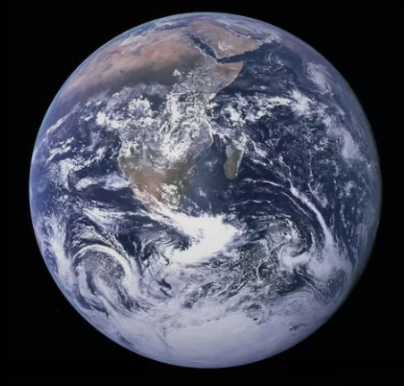
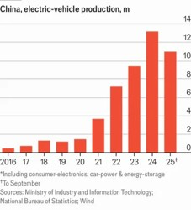
The Big Picture
North America & Europe
Population, 2025
Energy Consumption, 2023
Economy, 2026
Victor Glover Artemis II
~ 16%
~ 36%
~ 53%
1.3
Billion
223
Exajoules
Prosperity
$65
Trillion
Data: World Population Review. International Monetary Fund. Energy Institute Statistical Review of World Energy.

Slide 3
Asia & Africa
Population, 2025
Energy Consumption, 2023
Economy, 2026
Poverty
5.9
Billion
397
Exajoules
$41
Trillion
~ 72%
~ 48%
~ 33%
Data: World Population Review. International Monetary Fund. Energy Institute Statistical Review of World Energy.

Slide 4




“Energy Transition”

Slide 5

100%
Energy Transition
1
from Molecules to Electrons?
from “Fossils” to “Renewables?”
from “Dirty” to “Clean?”
“Clean”
2
Energy Security
Trade Offs
3
4
5
6
Affordable Reliable
7
8
12
13
11
9
0%
10
0%

Slide 6
People
Demand
Physics
Economics
Security
Optimization
Environment
Resources

Slide 7
Demand
Physics
Resources
Energy
Economics
Security
Environment
People

Slide 8

Demand

Slide 9
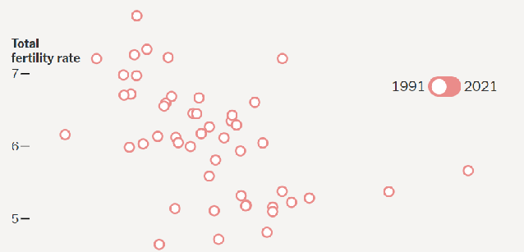
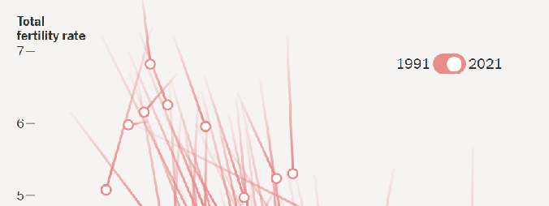
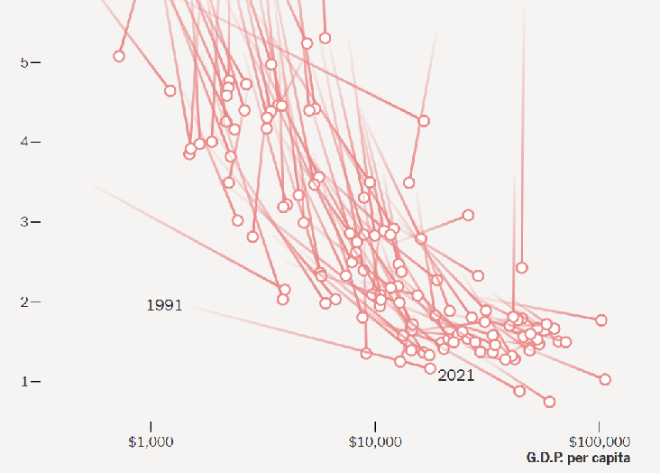
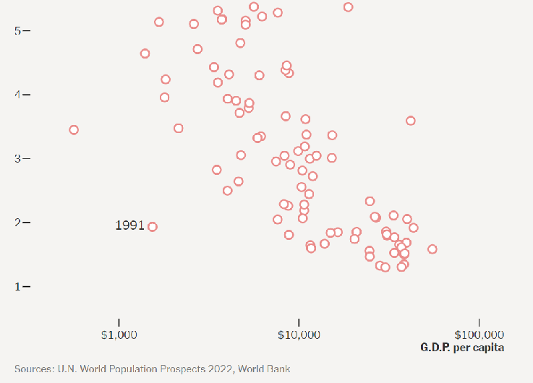
1991
2021
Global Fertility Rates
by country
6
2021 Fertility Rates
China 1.2
East Asia 1.2
Europe 1.5
U.S. 1.7
Latin Am 1.9
India 2.1
5
Fertility rates fall with GDP
What do these trends portend?
4
Fertility Rate
3
2
Replacement Fertility 2.1
$50,000
Developed
1
$1,000
$5,000
$10,000
$50,000
$100,000
Modified from Dean Spears. NYT.
U.N. World Population Prospects. World Bank
GDP/Capita

Slide 10

Global Population
2085
10 billion people
2022
8 billion people
The first commercial steam locomotive, 1804 in Wales
Gas
?
Oil
Coal
1804
1 billion people
1000 B.C.
110 million people
Modified from Dean Spears. NYT Opinion. 2023

Slide 11
Global Population
2085
10 billion people
2075
9 billion people
Significant Implications!
For now let’s focus on…
2022
8 billion people
?
Gas
If the world had today’s US fertility rates
Oil
Getting to 2075!
Coal
1804
1 billion people
1000 B.C.
110 million people
Modified from Dean Spears. NYT Opinion. 2023

Slide 12
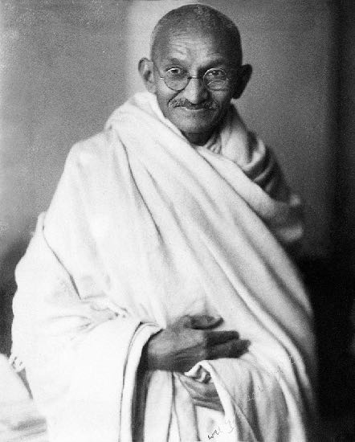
“Poverty is the worst form of violence.”
-Mahatma Gandhi

Slide 13
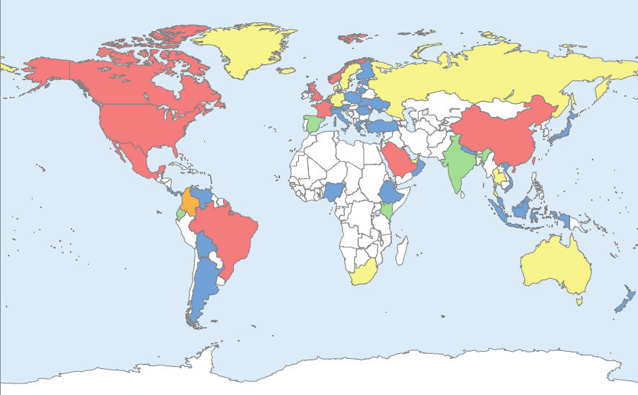
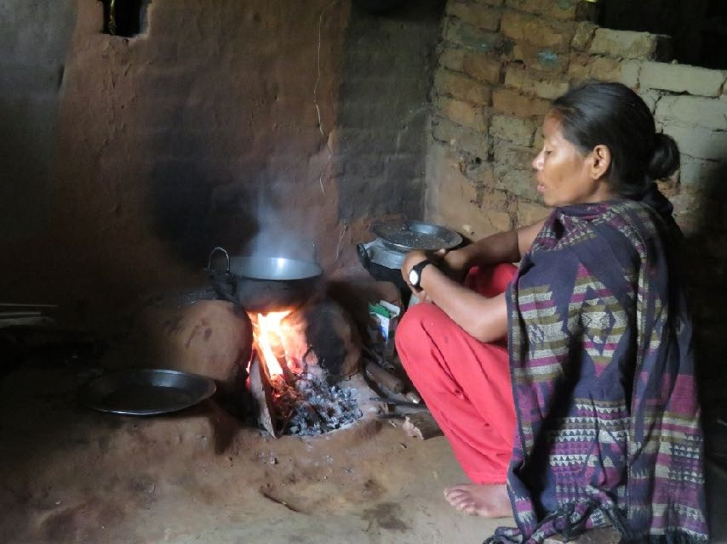
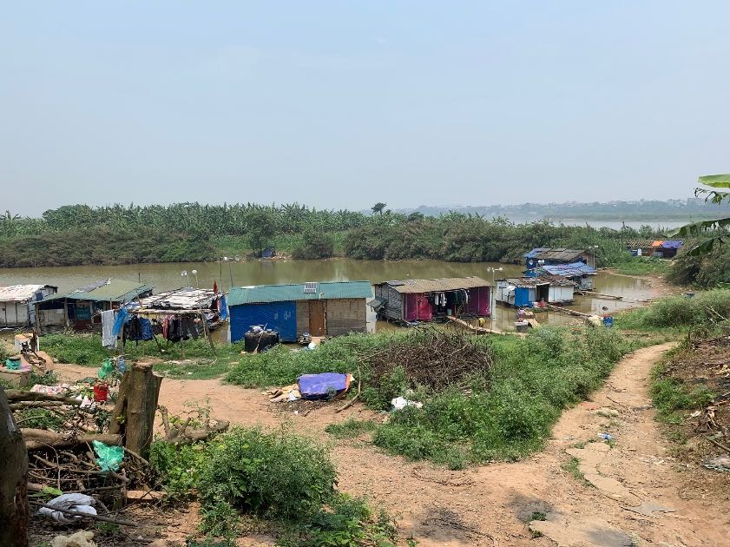
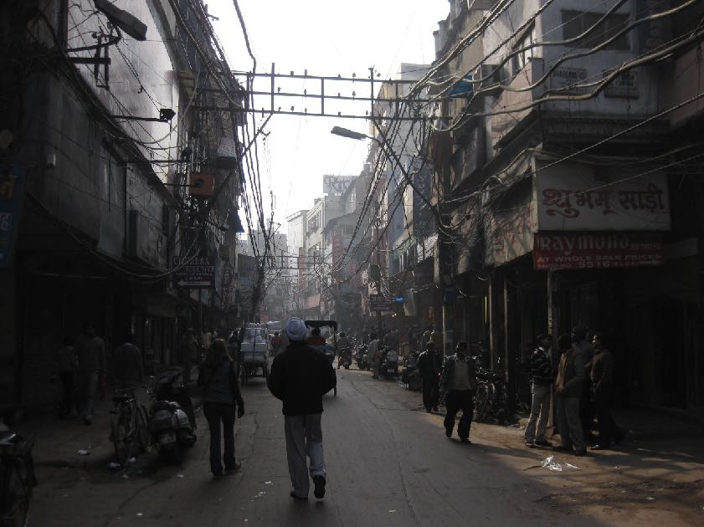






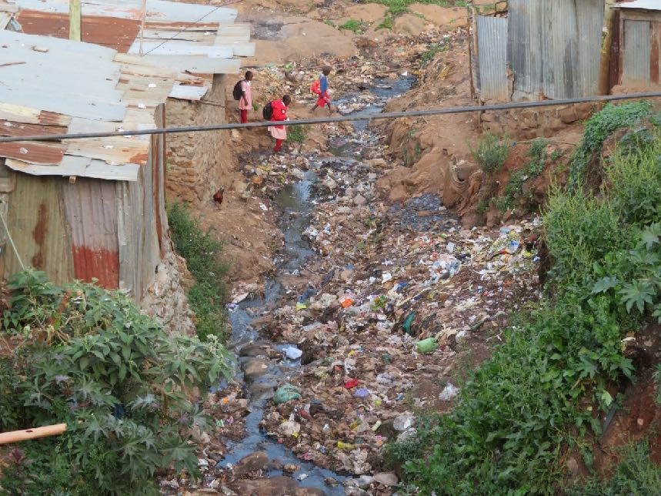




Switch
Switch On
see Switch On, Lynch and Tinker, 2020

Slide 14
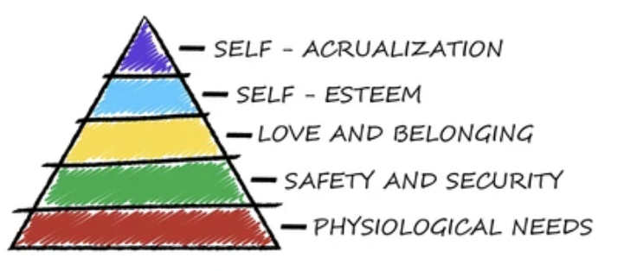
Self Actualization
Maslow
Self Esteem
Love & Belonging
Safety & Security
Energy
Income
Physiological

Slide 15

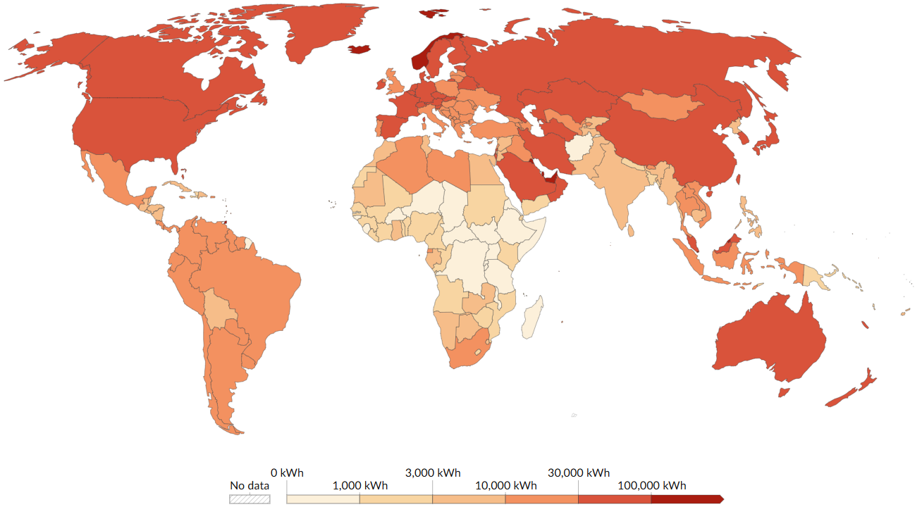
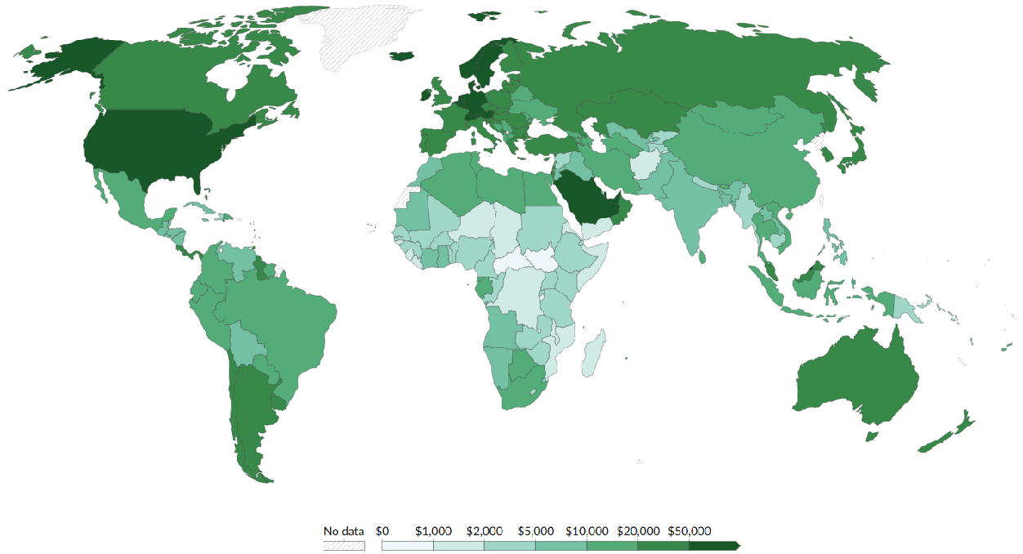
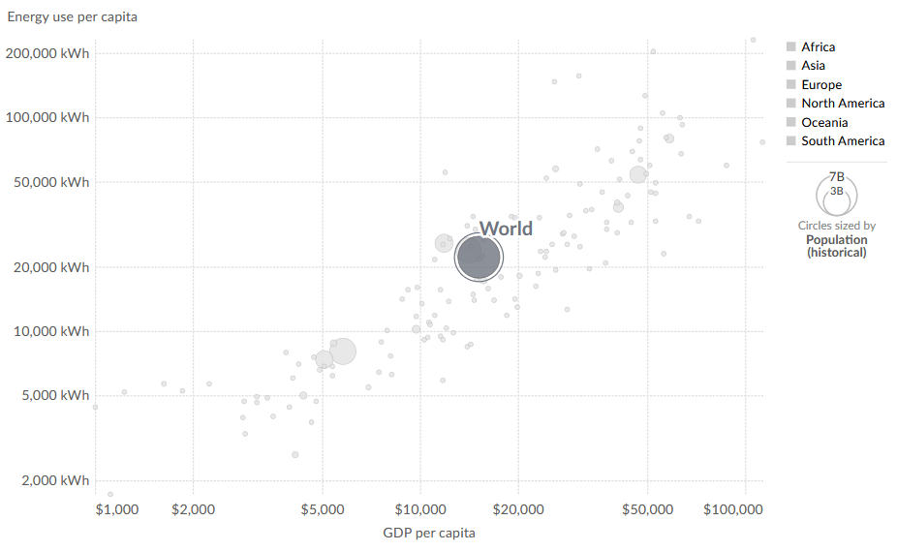
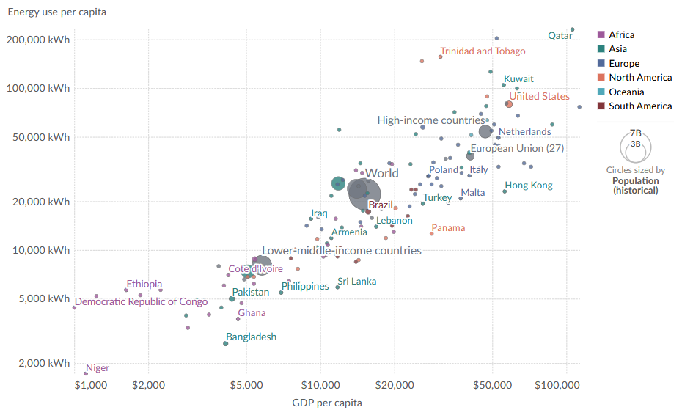
GDP/Capita vs Energy/Capita
Energy/Capita
Log Scale
200 MWh
100 MWh
50 MWh
~ 1.3 Billion People
Developed
50 MWh
> 50 MWh/yr
~1.3 B people
2075
Developing
20 MWh
>7 Billion People
~ 25 MWh/yr
~ 3 B people
$50,000
10 MWh
Emerging
5 MWh
< 10 MWh/yr
~4 B people
Energy/Capita
GNI/Capita
2 MWh
$1000
$2000
$5000
$10,000
$20,000
$50,000
$100,000
GDP/Capita
Data source: Multiple sources compiled by World Bank (2024); World Bank (2023). OurWorldInData.org

Slide 16
Completely Factual
Factually Complete
Global Energy Security
is improving
and
~ 85% of humans don’t have Secure Energy
Contradictory?

Slide 17

A Paradox
Energy Won’t End Poverty
But We Can’t End Poverty Without Energy
It’s time to Power
All the People
Notes:
a seemingly absurd or self-contradictory statement or proposition that when investigated or explained may prove to be well founded or true.

Slide 18
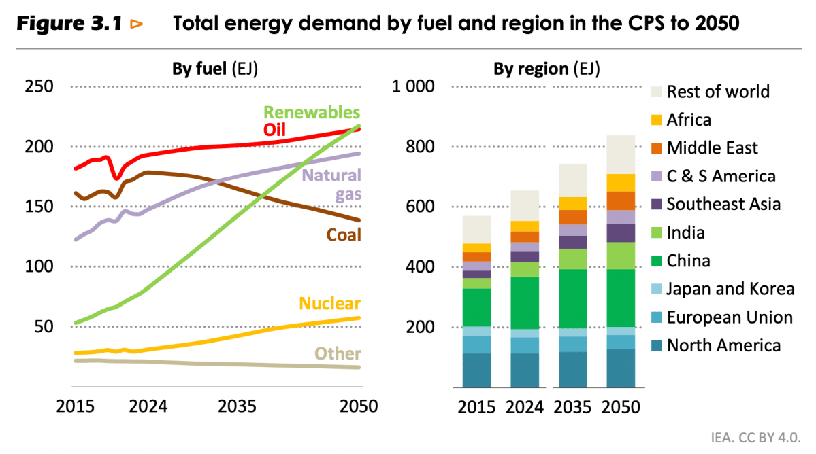
Global Primary Energy
50/50/50 Scenario
~1800
Energy Addition
Geo, Bio
Solar, Wind
Hydro, Nuclear
~8X
~630
Natural Gas
Oil
Coal
~2X
Data: Energy Institute Statistical Review of World Energy. World Bank for historical GDP data. Future Scenario Tinker
Notes:
Primary

Slide 19


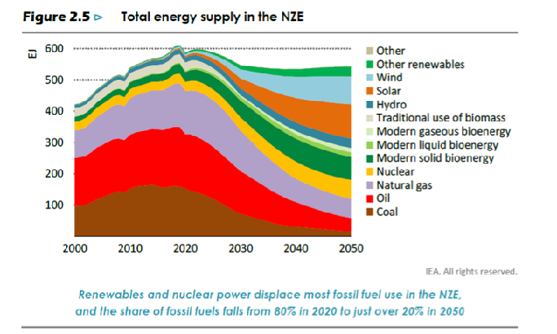
Total Energy Supply
IEA 2021: Net Zero Emissions (NZE)
600
Decreased Energy
600
Other renewables
Other renewables
Wind
500
Wind
500
Solar
Solar
Hydro
Hydro
400
400
And then there is this…
Traditional biomass
Traditional biomass
Gaseous bioenergy
Gaseous bioenergy
EJ
EJ
300
300
Liquid bioenergy
Liquid bioenergy
Solid bioenergy
Solid bioenergy
200
200
Nuclear
Nuclear
Natural gas
Natural gas
100
100
Oil
Oil
Coal
Coal
2000
2000
2010
2010
2020
2020
2030
2030
2040
2040
2050
2050
2021
Source: IEA, 2021, Net Zero by 2050: A Roadmap for the Global Energy Sector

Slide 20
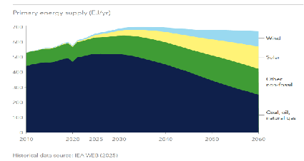
DNV Energy Transition Outlook, 2025
Primary Energy Supply (EJ/yr)
700
Decreased Energy
600
Wind
500
Solar
400
Hydro, Nuclear, Bio, Geotherm, Other non-Fossil
300
200
Coal, Oil,
Natural Gas
100
0
2010
2020
2030
2040
2050
2060
Note: Historical data source: IEA WEB (2025)
Source: DNV Energy Transition Outlook. 2025

Slide 21
Global Primary Energy
Scenario
Geo, Bio
Solar, Wind
Hydro, Nuclear
Prosperity
Natural Gas
Oil
Coal
Poverty
IEA
NZE ‘21
Poverty
DNV ‘25
Data: Energy Institute Statistical Review of World Energy. World Bank for historical GDP data. Future Scenario Tinker

Slide 22
Global Primary Energy Mix
50/50/50 Scenario
6%
15%
24%
More Options Improve
Energy Security
Fewer Options Hinder
Energy Security
Energy Transition
44%
79%
32%
Data: Energy Institute Statistical Review of World Energy, Future Scenario Tinker

Slide 23
The Mix of primary energy sources is in Transition
and
Consumption of primary energy is in Addition
I believe the Real
Energy Transition
is from Poverty
to Prosperity

Slide 24

Physics

Slide 25

“Reality is that which,
when you stop believing in it,
doesn’t go away.”
- Philip K. Dick

Slide 26










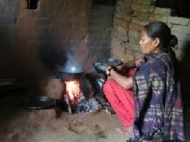





Energy through Time
Energy Density
https://en.wikipedia.org/wiki/Energy_density
~10,000 BC
~2000 AD
Energy by Weight
Nuclear fission is ~ 5,000,000 X denser than coal
Hydro, Geothermal, Wind, Solar
Time

Slide 27
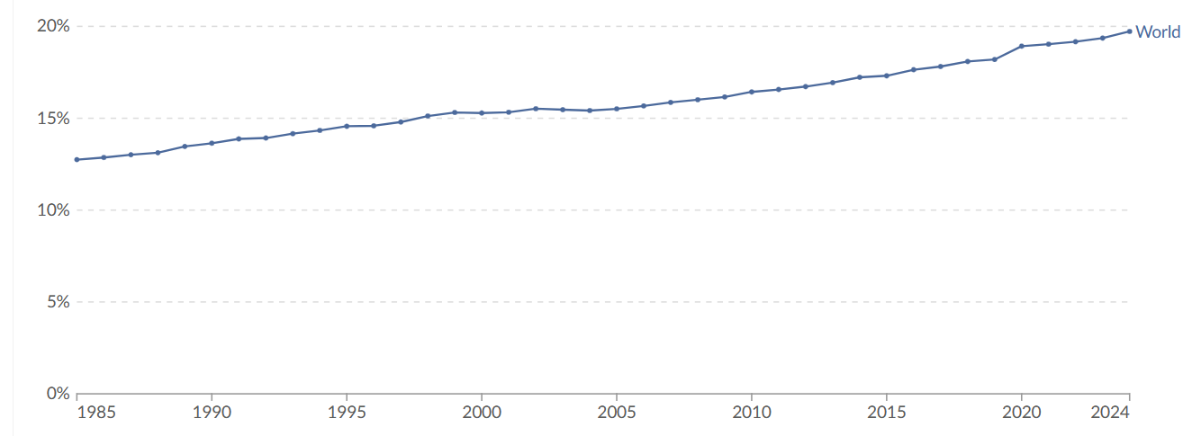
Energy Density
Energy by Area
Source: Our World in Data
~ 20%
Cement, Steel,
Ammonia, Plastics
Clean
Weather Dependent
Intermittent
Renewable
Electrons
Molecules
Thermal
Reliable
Firm
Dirty
Secure Energy needs
Electricity and Molecules
Electricity as a Share of
End Use Energy Consumption
Smil: https://en.wikipedia.org/wiki/Surface_power_density

Slide 28
Electricity’s share of end use energy consumption is growing
and
Electricity is less than 25% of
end use energy consumption

Slide 29

Resources

Slide 30
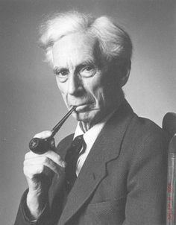
What is wanted is not the will to believe, but the will to find out, which is the exact opposite.
- Bertrand Russell

Slide 31
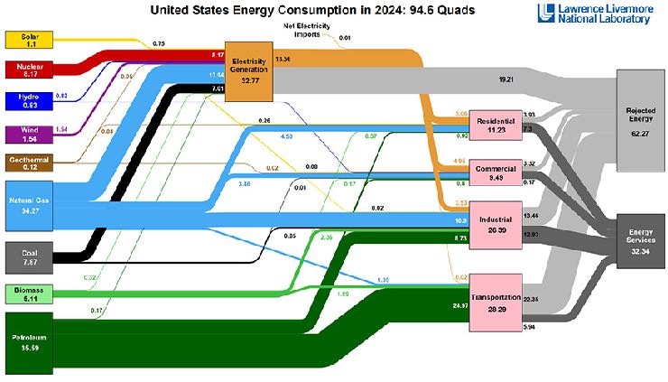
U.S. Energy Consumption in 2024: 94.6 Quads
Solar 1.1
0.75
Net electricity imports 0.01
8.17
Electricity
generation
32.77
13.56
Nuclear 8.17
13.94
7.01
19.21
Hydro 0.83
0.83
1.54
5.06
3.93
Rejected
energy
62.27
0.05
0.04
0.26
Residential
11.23
Wind 1.54
4.58
0.92
0.37
7.3
Geothermal 0.12
0.02
0.08
4.95
Commercial
9.49
3.32
3.46
0.17
0.8
6.17
Natural gas 34.27
0.01
0.02
3.53
10.9
Industrial
26.39
13.46
0.85
12.93
Energy
services
32.34
2.36
8.73
Coal 7.87
0.02
0.32
1.39
Biomass 5.11
1.89
Transportation 28.29
22.35
0.17
24.97
Petroleum
35.59
5.94
Sources: LLNL

Slide 32
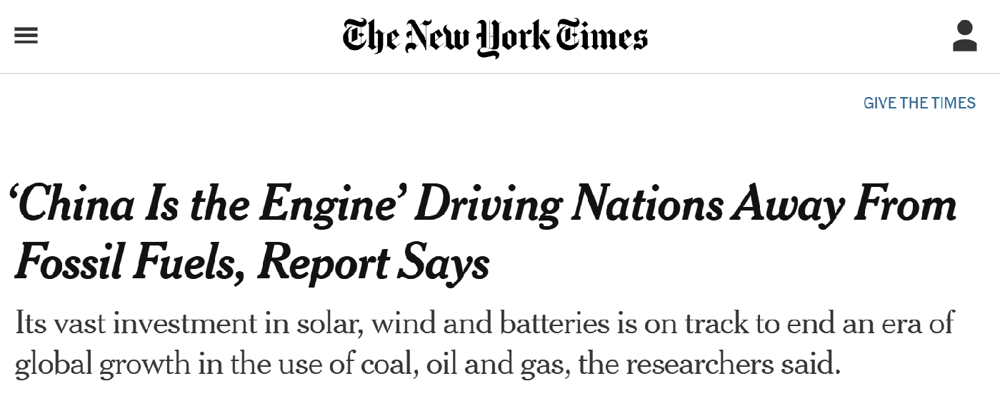

Non-Hydro “Renewable” Consumption
Data: Energy Institute Statistical Review of World Energy, Analysis Tinker

Slide 33
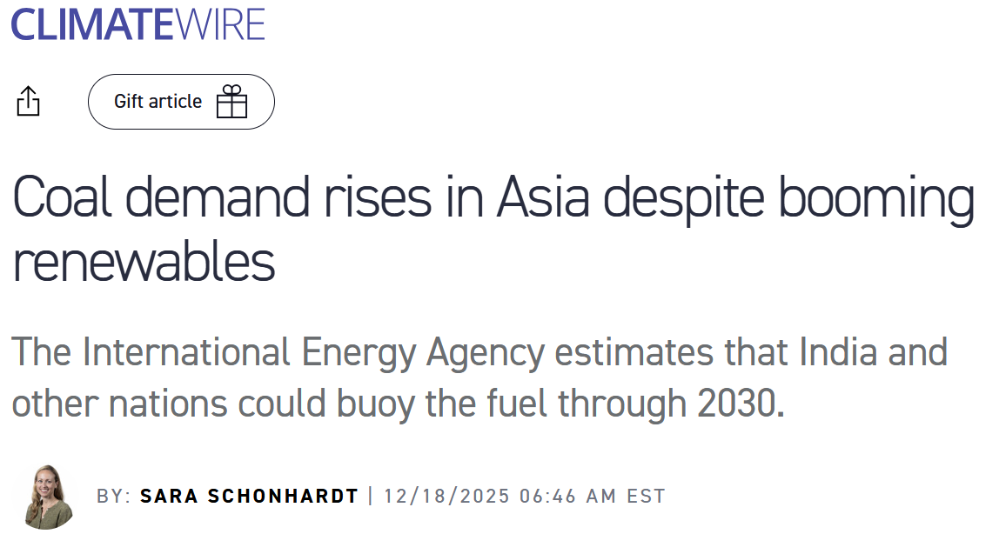
China
Energy Consumption (EJ)
Completely Factual
Factually Complete
Data: Energy Institute Statistical Review of World Energy, Analysis Tinker

Slide 34
China leads the world in
Wind and Solar
and
Coal and Oil in China have grown more than Wind and Solar

Slide 35
China v India
Energy Consumption (EJ)
?
Data: Energy Institute Statistical Review of World Energy, Analysis Tinker

Slide 36
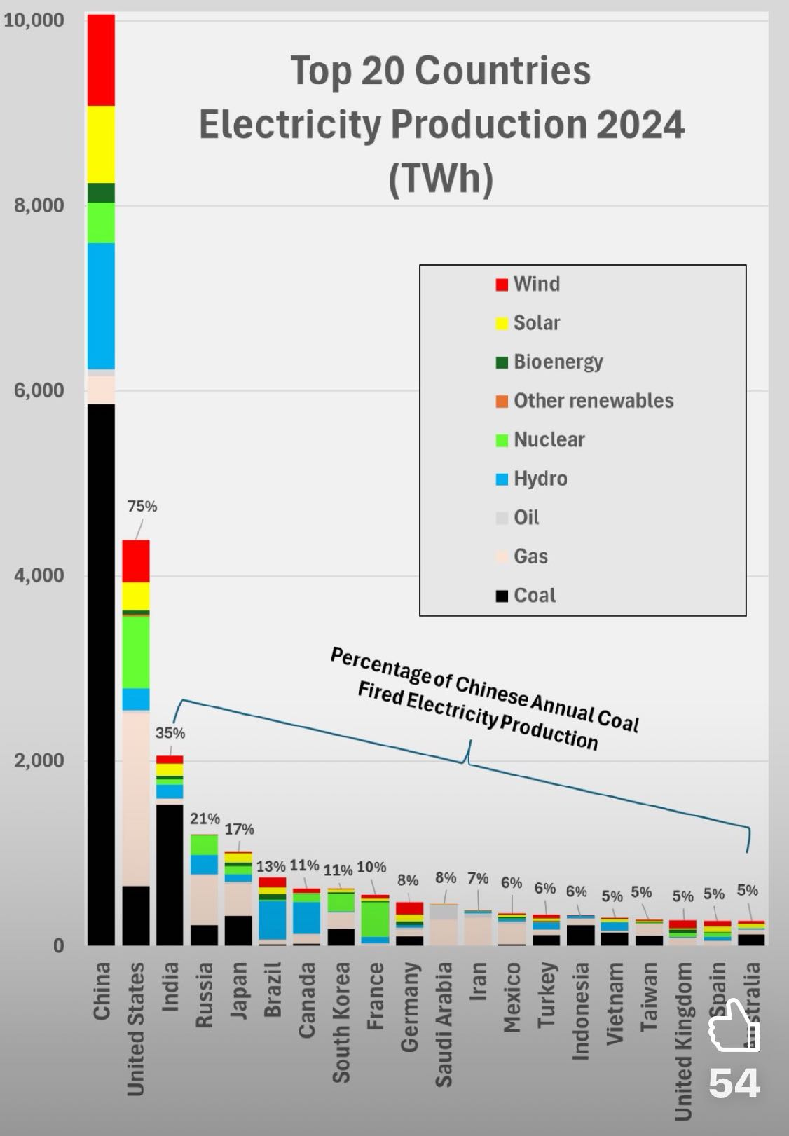
Top 20 Countries
Electricity Production 2024 (TWh)
10,000
Wind
Hydro
Solar
Oil
8000
Bioenergy
Nat Gas
Geotherm & Oth
Coal
Nuclear
6000
Completely Factual
Factually Complete
TWh
4000
2000
0
China
United
States
India
Russia
Japan
Brazil
South
Korea
France
Saudia
Arabia
Iran
Mexico
Taiwan
Turkey
Vietnam
United Kingdom
Germany
Spain
Indonesia
Australia
Canada
Data: Energy Institute Statistical Review of World Energy, 2024

Slide 37
Global Oil Consumption
Data: Energy Institute Statistical Review of World Energy, Analysis Tinker

Slide 38

Coal and Oil are decreasing
in the global energy Mix
and
Coal and Oil Consumption
is increasing globally

Slide 39

Global Natural Gas Consumption
2007
Data: Energy Institute Statistical Review of World Energy, Analysis Tinker

Slide 40
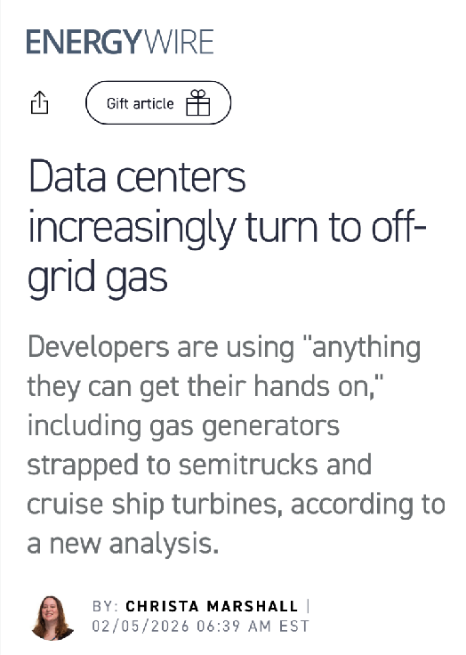
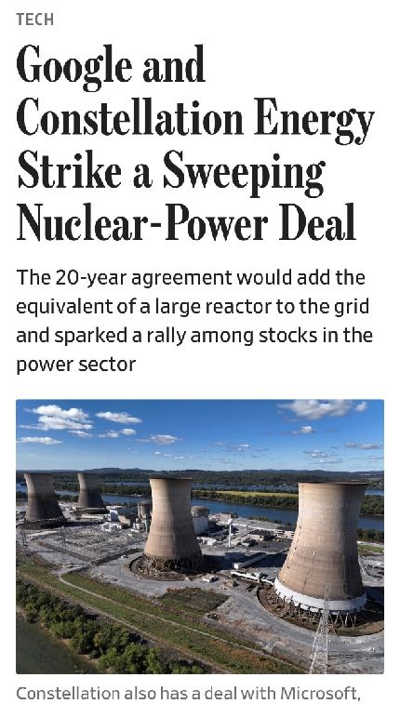
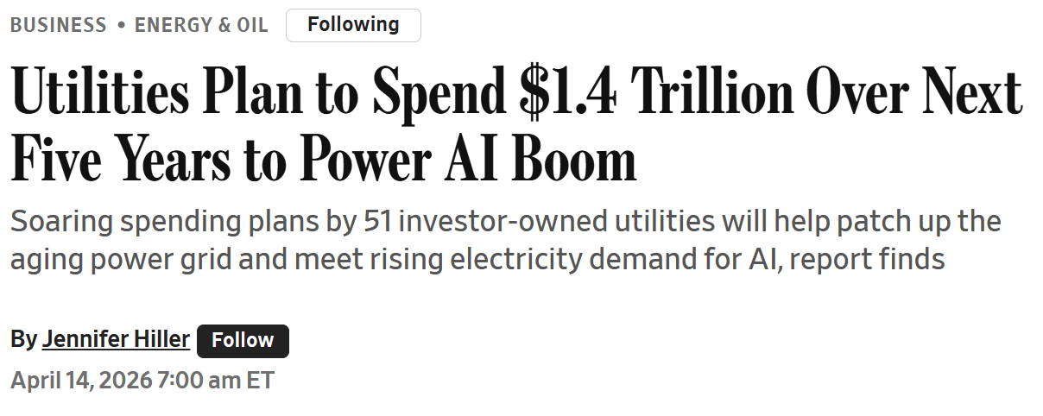
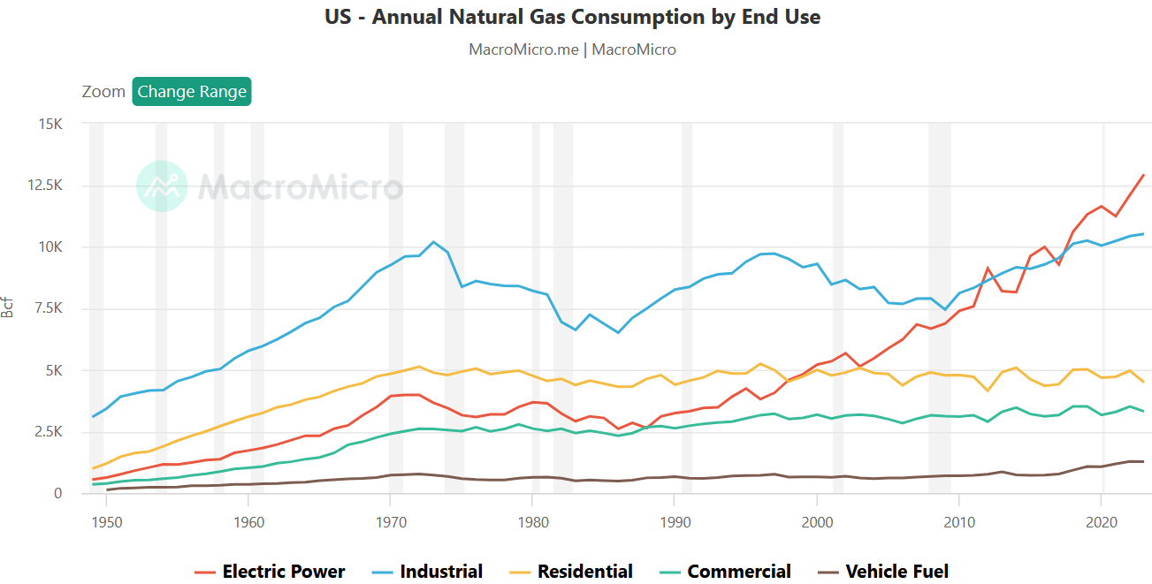
U. S. Natural Gas Consumption
15
Electric power
Industrial
AI Hyperscalers demand reliable electricity.
Gas (or Nuclear)
Residential
10
Commercial
Tcf
Transportation
5
1950
1960
1970
1980
1990
2000
2010
2020
Source: MacroMicro.me

Slide 41
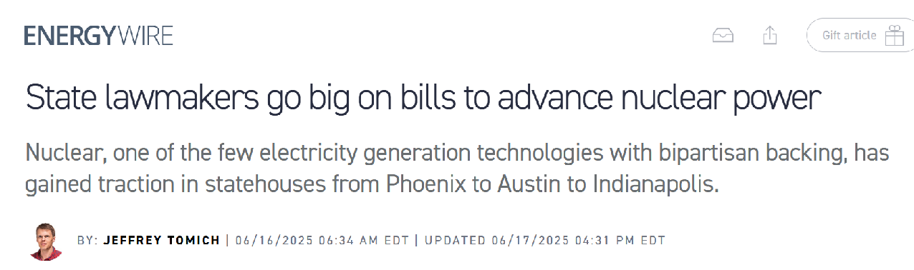
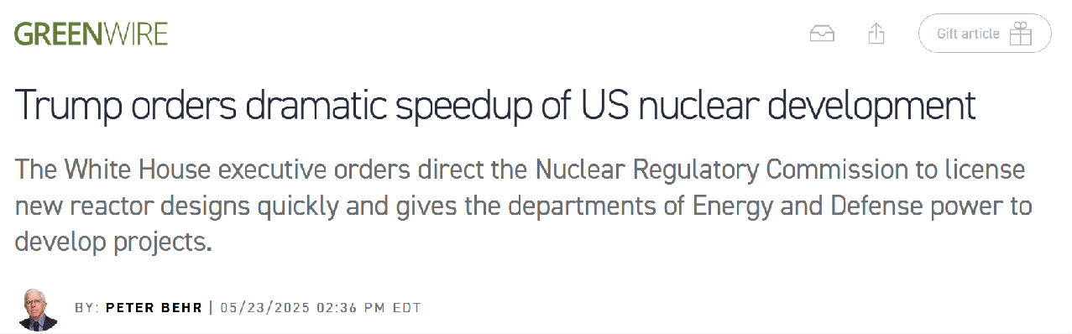
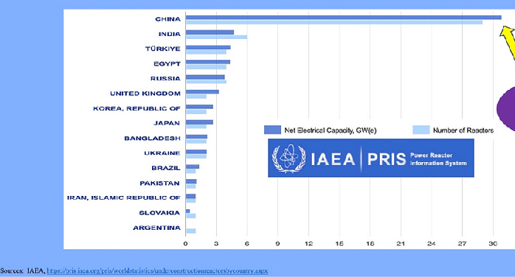
Nuclear Under Construction
China
India
Turkey
Egypt
Russia
Nuclear is mostly an Asian story
United Kingdom
Net Electrical Capacity GW(e)
South Korea
Japan
Number of Reactors
Bangladesh
Ukraine
Brazil
Pakistan
Iran
Slovakia
Argentina
0
3
6
9
12
15
18
21
24
27
30
Sources: IAEA, https://pris.iaea.org/pris/worldstatistics/underconstructionreactorsbycountry.aspx

Slide 42
Global Solar and Wind Consumption
Scale!
Data: Energy Institute Statistical Review of World Energy, Analysis Tinker

Slide 43
Wind and Solar are the fastest growing sources of energy
and
Wind and Solar represent
< 5% of global energy

Slide 44

Economics

Slide 45
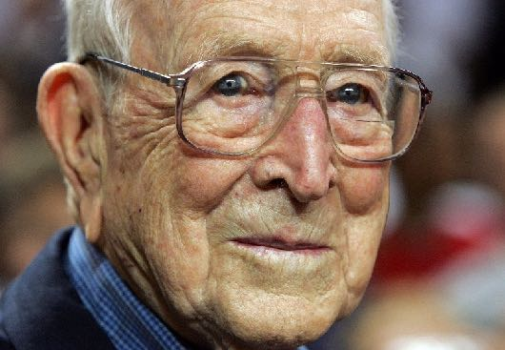
“Failure is not fatal, but failure to change might be.”
– John Wooden

Slide 46
Europe Primary Energy
2007
Data: Energy Institute Statistical Review of World Energy, Analysis Tinker
QAf69

Slide 47
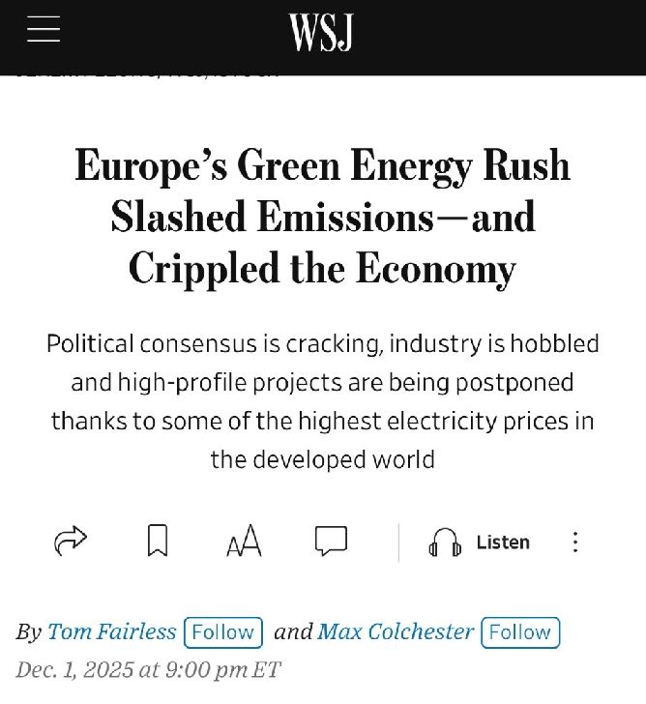
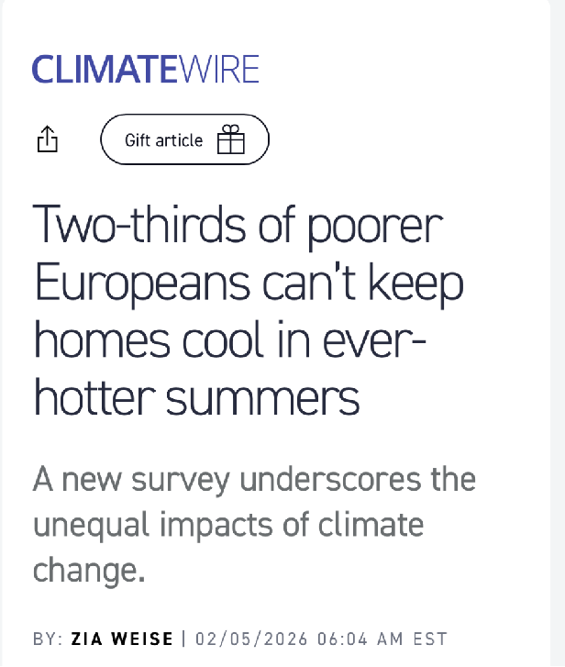
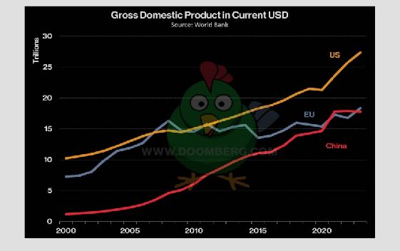
Gross Domestic Product
Current USD
30
25
afford to
U.S.
Affordable and Reliable energy underpins healthy economies
Europe
20
2007
China
$ Trillions
15
10
5
0
2000
2005
2010
2015
2020
Source: World Bank
QAf69

Slide 48
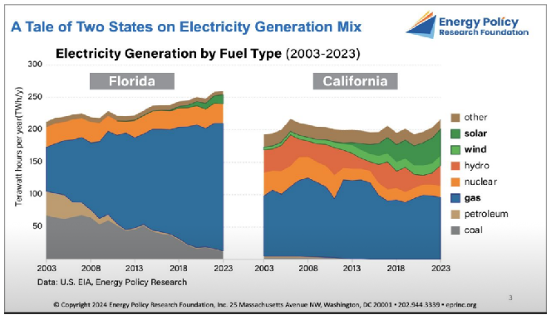
Electricity Generation
2003–2023
California
California
Florida
Florida
250
250
250
Other
Other
200
200
Solar
200
Solar
Wind
150
Wind
Dense
150
Terawatt hours per year (TWh/y)
150
Hydro
Hydro
100
Nuclear
Nuclear
100
100
Not Dense
Gas
Gas
50
50
Petroleum
50
Petroleum
Coal
0
Coal
0
0
2003
2013
2023
2003
2013
2023
2013
2013
2023
2003
2023
2003
Source: U.S. EIA, Energy Policy Research

Slide 49

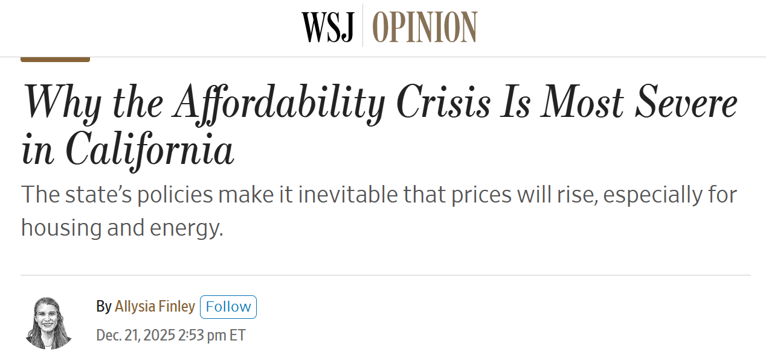
Residential Electricity Prices
(Monthly: March 2004 – March 2024)
40
35
But I heard
solar and wind are cheaper?
32.5
30
25
California
Newsom
Governor
Cents per kilowatthour
20
15
12.1
14.7
10
DeSantis
Governor
8.9
Florida
5
0
2004
2008
2012
2016
2020
2024
Source: EIA
QAf96

Slide 50
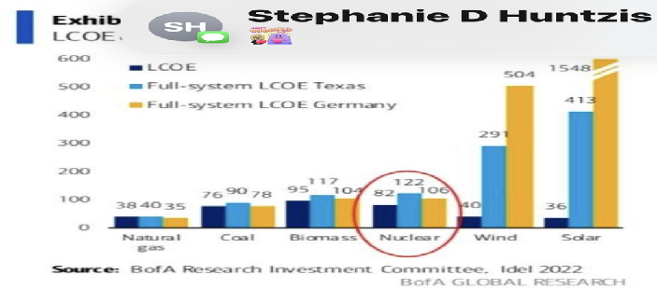
“Levelized” Cost of Electricity
(Euro/MWh)
1548
600
500
Full-system LCOE Texas
Reliability adds Cost
400
Full-system LCOE Germany
300
200
100
0
Natural gas
Coal
Biomass
Nuclear
Wind
Solar
Source: B of A Research Investment Committee, Idel 2022

Slide 51
Wind and Solar are often more affordable where generated
and
Wind and Solar are often less affordable to the consumer

Slide 52

Security

Slide 53

“In theory there ain’t no difference between theory and practice.
But in practice there is.”
- Yogi Berra

Slide 54
Gas Consumption v. Production
Low reserves and high LNG imports
Data: Energy Institute Statistical Review of World Energy, Analysis Tinker

Slide 55
Oil Consumption v. Production
Europe and Asia need options to oil and gas
Low reserves and high imports
Data: Energy Institute Statistical Review of World Energy, Analysis Tinker
Notes:
Change to MBOD

Slide 56
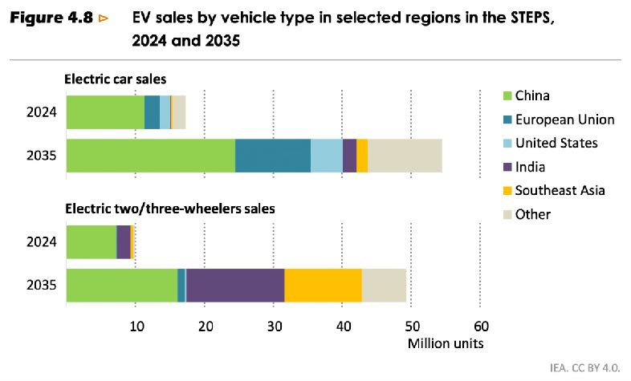
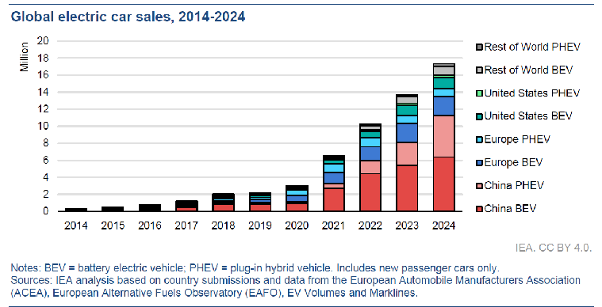
~ 70% of all cars
25 20
23
26
30
33
30 36
39
42
45
48
35 52
Electric Car Sales
20
~ 80 million / ~1.4 billion
~ 6% of the global fleet
is electrified
Rest of World PHEV
18
~ 83% of Electric Cars are China and Europe
30%
16
Rest of World BEV
14
United States PHEV
Year | EV/yr (million)
pre 25 total | 60
25 | 20
 | 23
 | 26
 | 30
 | 33
30 | 36
 | 39
 | 42
 | 45
 | 48
35 | 52
Total sold | 454
Total cars | 1500
% EVs | 30%
This is representative
United States BEV
12
20%
Europe PHEV
10
Million
Europe BEV
8
    Demand for oil is not going away any time soon
China PHEV
6
10%
China BEV
4
Share of
global sales
2
0
0%
2014
2015
2016
2017
2018
2019
2020
2021
2022
2023
2024
Notes: BEV = battery electric vehicle; PHEV = plug-in hybrid vehicle. Includes new passenger cars only.
Sources: IEA analysis based on country submissions and data from the European Automobile Manufacturers Association (ACEA), European Alternative Fuels Observatory (EAFO), EV Volumes and Marklines.

Slide 57
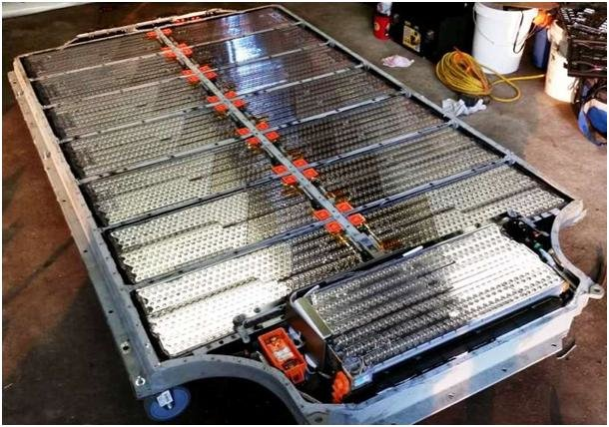
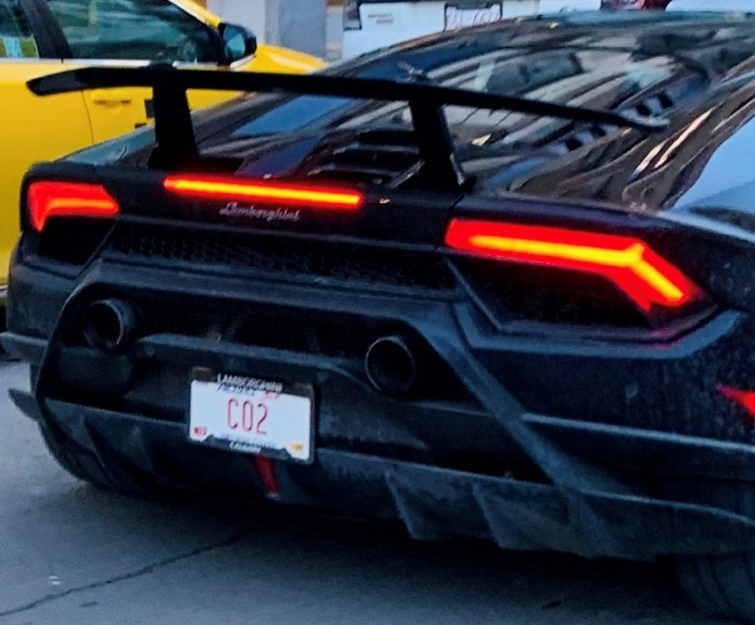
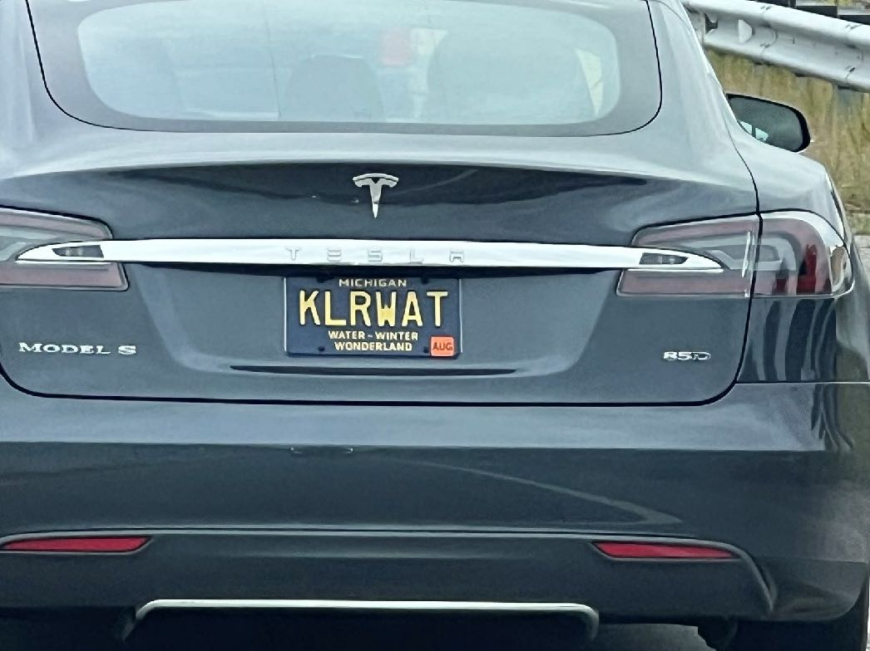

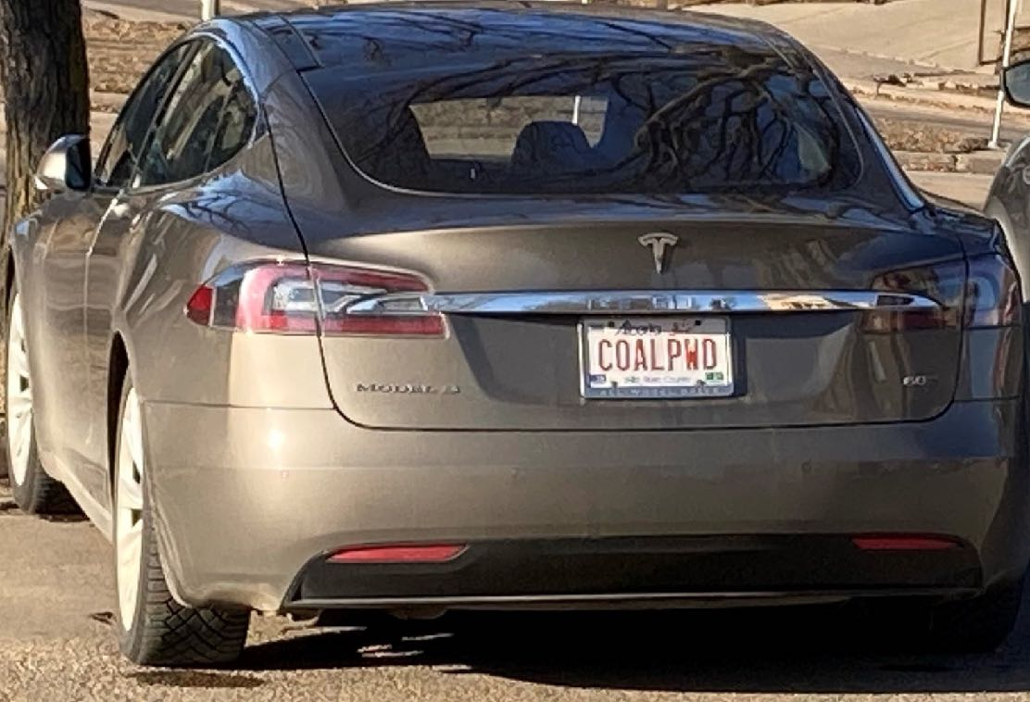
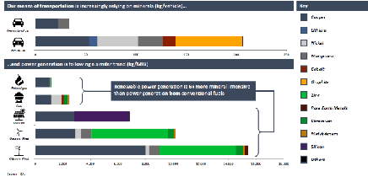
Raw Materials
Transportation
kg/vehicle
Copper
ICE
EVs are ~ 600% more mineral-intensive than ICEs
Lithium
EV
Nickel
0
50
100
150
200
250
Manganese
Power Generation
Cobalt
KG/MW
Energy Density in Practice
Graphite
Natural gas
Zinc
Solar and Wind are ~ 500% more mineral-intensive than conventional fuels
Rare Earths
Coal
Chromium
Solar PV
Molybdenum
Onshore wind
Silicon
Offshore wind
Others
0
2,000
4,000
6,000
8,000
10,000
12,000
14,000
16,000
18,000
Source: IEA

Slide 58
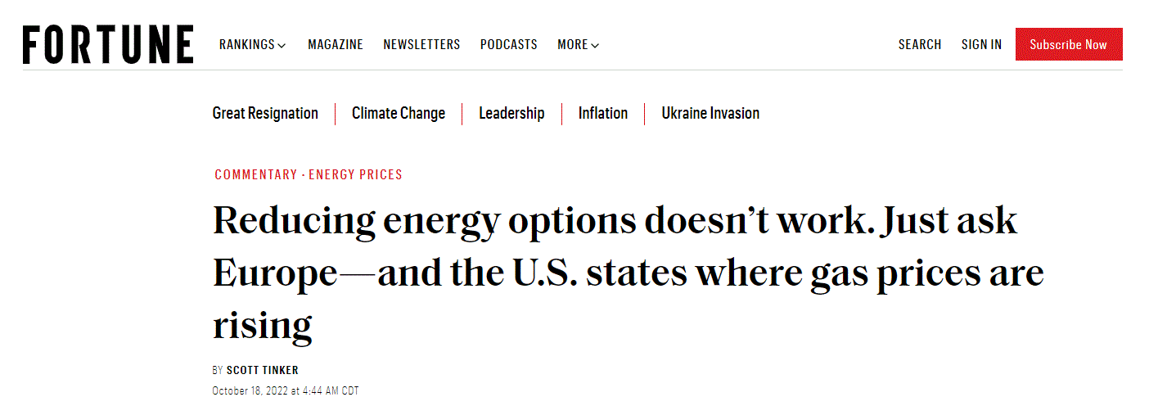
Transportation Optionality
Smaller: Hybrid and Electric
Mid-Sized: Fuel Cells (H₂), CNG
Large: Gasoline, Diesel, Kerosene

Slide 59
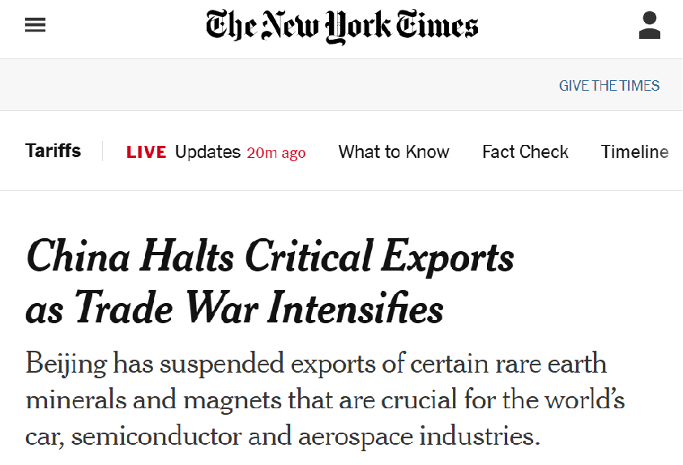




Critical Minerals Supply, 2024
% of Total
Mining
Refining/Processing
0
20
40
60
80
100
0
20
40
60
80
100
Are solar, wind and batteries more secure?
Graphite
Graphite
Tungsten
Gallium
Critical minerals, REEs, and metals represent an
Energy Security risk
Rare earths
China
Rest of World
Rare earths
Lithium
Lithium
Copper
Copper
Nickel
Cobalt
Sources: IEA; USGS

Slide 60
Batteries reduce dependency on OPEC for transportation fuels
and
Batteries increase dependency on China for transportation fuels

Slide 61

Environment
Notes:
Have managed the Iran war by managing their very large stock piles (2.5mbd), controlling and reducing exports (0.5mbd), and lowering demand (2.7mbd).

Slide 62

It is the mark of an educated mind to be able to entertain a thought without accepting it.
-Aristotle

Slide 63
Environmental
Security
Atmosphere
Water
Air
Land
Economic
Security
Energy
Security

Slide 64





























Are there “clean” resources and “dirty” resources?
Grow, Mine
Manufacture, Process
Drill, Deploy
Refine
Transport, Transmit
Combust, Landfill Disposal
Grow, Mine
Manufacture, Process
Drill, Deploy
Refine
Transport, Transmit
Combust, Landfill Disposal
Grow, Mine
Manufacture, Process
Drill, Deploy
Refine
Transport, Transmit
Combust, Landfill Disposal
Grow, Mine
Manufacture, Process
Drill, Deploy
Refine
Transport, Transmit
Combust, Landfill Disposal
We either Mine it
or we Drill it
All forms of Energy have Trade Offs
No form of energy is “Renewable”
Life Cycle Impacts
De Soto, near Kansas City

Slide 65
“Renewables” and EVs have a smaller Emissions impact
and
“Renewables” and EVs have a
larger Land impact

Slide 66
Annual CO₂ Equivalent Emissions
Asia emits more CO₂ today than the rest of the world combined
Data: Energy Institute Statistical Review of World Energy, Analysis Tinker

Slide 67

CO₂ Emissions / GDP
0.40
0.35
0.30
0.25
Mt CO₂ per $1,000 Global GDP
(2017 PPP)
Kyoto Protocol
1997
0.20
0.15
Paris Accords
2016
0.10
0.05
0.00
1995
2000
2005
2010
2015
2020
Source: World Bank, Global Carbon Project

Slide 68


CO₂ Emissions
Consumers and Producers
“CO₂”
40
OECD countries
Non-OECD countries
Asia makes “dirty” stuff
Germany
20
One Atmosphere
Zero Emissions?
Russia
Iran
~5 Gt
Indonesia
~10 Gt
Saudi
Arabia
Mexico
Consume more
Western Europe
Consumption vs. Production
(emissions %)
0
Produce more
Canada
United States
Brazil
Japan
China
India
Britain
Australia
-20
South
Korea
Stuff
-40
5
10
15
20
25
30
CO₂ Emissions (Gigatonnes)
Source: Global Carbon Project; World Bank; The Economist

Slide 69
Emissions are decreasing in the Developed World
and
The Developed World is “outsourcing” its emissions to the Developing World

Slide 70

People

Slide 71

The First Curve: Fluid Intelligence
Raw brainpower. Your ability to think fast, solve new problems, and focus deeply.
Peaks in your 20s and 30s and declines.
Impact
Geoscientist
Time
After From Strength to Strength - Arthur Brooks

Slide 72
Educator
The Second Curve: Crystallized Intelligence
Wisdom. Your ability to use the knowledge and experience you have stored up over the years to see the big picture.
Rises in your 40s and stays strong into your 70s and 80s.
Teaching, mentoring, managing, and synthesizing complex ideas.
Impact
Geoscientist
Time
After From Strength to Strength - Arthur Brooks

Slide 73








Speaking
TV: PBS
Students
Non-Profits
Films
Radio: NPR
Testimony
Writing
Podcasts

Slide 74

“The ultimate question of life, the universe, and everything else…”
The Hitchhiker's Guide to the Galaxy
Douglas Adams, 1979
42
Deep Thought Supercomputer
(after ~ 7.5 My…)

Slide 75
42
Educator
Impact
Geoscientist
Would everyone under the age of 42 please raise your hand…
Time
After From Strength to Strength - Arthur Brooks

Slide 76
Closing
Thoughts

Slide 77

“No one will place the truth in your mind.
It is something you must discover for yourself.”
- Noam Chomsky

Slide 78


Food, Shelter, Water, Light
Immigration and Migration
Secure Energy underpins solutions to global challenges
~ 47% of global energy
Environmental
Investment
Climate Mitigation & Adaptation
Population Growth
Rights and Empowerment of Women
Education and Health Care
< 7% remains
Emerging
Developing
Developed
Data: Energy Institute Statistical Review of World Energy, Analysis Tinker

Slide 79
Environmental Protection
A False Choice
Abundant
Energy
AND
Environmental Protection
Economic Flourishing
OR
Abundant
Energy

Slide 80











Environmental Protection
Poor countries can’t afford to clean up the environment
Developed
“Clean”
The
Power of
AND
Secure Energy
Healthy Economy
Environmental Protection
Economic Prosperity
Energy Security
Developing
Emerging
Source: World Health Organization
Air Quality
Unsafe Drinking Water
Affordable Reliable
Cleaner (<10)
Dirtier (>80)

Slide 81
Summary
    Secure Energy enables Human Prosperity
    Humans need Electrons and Molecules
    Global demand for Resources will grow
    Diverse Energy Portfolios are healthy
    China controls Solar, Wind and Batteries
    All energy has Environmental Impacts

Slide 82
Musings
    It’s tough to negotiate with physics
    Civil dialog and critical thinking
    Factually Complete
    Educators, your role is vital!

Slide 83














Talks
TEDx
PBS
Slides
SEA
Films
Book
Podcasts

Slide 84


LinkedIn
Thanks!

